Slide 1

Computers and
Types of
Memories
Student Name : Yasalath Gedara Dinaya Madhurya
Student Number : CL/OTHMFL3/11/56

Slide 2
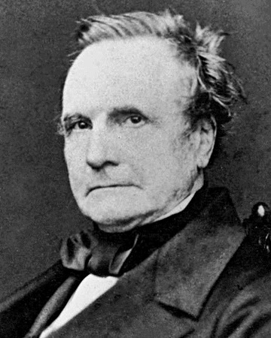
Computers…
A computer is a device of electrical
equipment used to manipulate data or information with a set of instructions that the user gives.
Data can be stored, retrieved, and processed by it.
For example we can use a computer to surf the Internet, send emails, type documents, and play games.
Charles Babbage
Year invented - 1822

Slide 3

TYPES OF
COMPUTERS
Super Computer: Use more than one central processing unit (CPU) & has a high level of performance than unspecialized computers. | Mainframe Computer: High performance machines with plenty of memory & data processors that can process trillions of simple computations. | Analog Computer: A computer that models the issue at hand using the continuous variation element of physical phenomena. | Workstation Computer: Used primarily to perform computationally intensive scientific and engineering tasks. | Digital Computer: Most used type. Operates on data, including magnitudes, letters, and symbols which are expressed in binary codes, 0 and 1 . | Hybrid Computer: Exhibit features of analog and digital computers. normally serves as the controller and provides logical and numerical operations

Slide 4
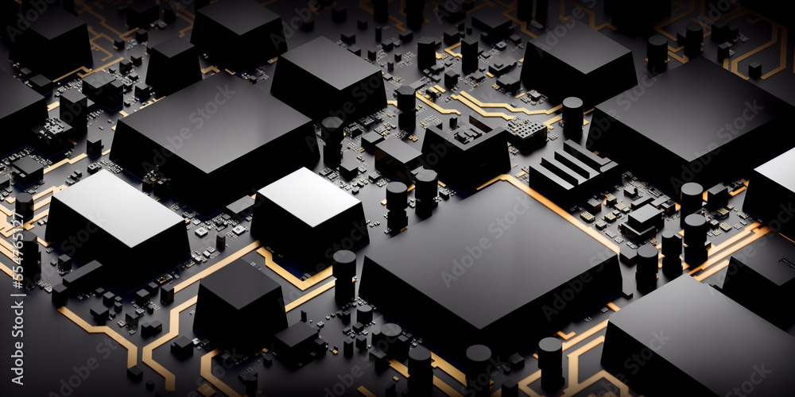
Computer
Memory

Slide 5

Types of Memory
Mainly there are 2 types of computer memory.
Primary Memory
Secondary Memory
Cache Memory

Slide 6

Primary Memory The area of the computer that houses the most recent copies of data, software, and instructions is referred to as primary storage or memory, sometimes known as the main memory. Since main storage is housed on the motherboard, data may be read and written to primary storage at a very fast rate. Examples : RAM, ROM, cache, PROM, EPROM, registers, etc. | Secondary Memory Secondary memory is non-volatile, permanent computer memory that is not directly accessible by a computer or processor. Data that can be quickly and easily retrieved, transmitted, and utilized by apps and services can be stored by the user and then used in this manner.
Examples :Hard Drive, SSD, Flash, Optical Drive, USD Drive

Slide 7

Primary Memory
Secondary Memory
Storage validity
Access
Volatility Storage
Division
Speed
Stored data
Primary memory is the main memory and stores data temporarily.
Secondary memory is the external memory and stores data permanently.
The CPU can directly access the data.
The CPU cannot directly access the data.
Primary memory is volatile. It loses data in case of a power outage.
Secondary memory is non-volatile; data is stored even during a power failure.
Data is stored inside costly semiconductor chips.
Data is stored on external hardware devices like hard drives, floppy disks, etc. Data is stored on external hardware devices like hard drives, floppy disks, etc.
It can divided into RAM and ROM
They do not have such a classification. Secondary memories are permanent storage devices like CDs, DVDs, etc.
Faster
Slower
It saves the data that the computer is currently using.
It can save various types of data in various formats and huge sizes.

Slide 8

Classification of Primary Memory
RAM (Random Access Memory) ROM (Read-Only Memory)
Any system process that needs to run is put into RAM and performed by the CPU. When we click on an application, such as a browser, the operating system first loads the necessary code into RAM, and then the CPU executes the code and launches the browser. DRAM (Dynamic RAM )-is widely used in home PCs and servers as it is cheaper than SRAM. Periodically refresh in a few milliseconds to retain data. SRAM (Static RAM) - keeps the data as long as power is supplied to the system. It’s expensive and hence only used where speed is the utmost priority. | Any data that doesn't need to be changed is saved in ROM. ROM contains data like algorithm needed by OS as well that execute during system booting (known as a bootstrap program) Nothing can be modified or altered once it is saved in ROM. MROM: Masked ROM is hardwired and pre-programmed ROM. Any content that is once written cannot be altered anyhow. PROM: Programmable ROM can be modified once by the user. But once written content cannot be altered. EPROM: Erasable and Programmable ROM After deleting the original content, ROM loses its charge, allowing for content rewriting. EEPROM: Electrically Erasable and Programmable ROM Slow process. One byte can be erased at a time instead of deleting in one go.

Slide 9
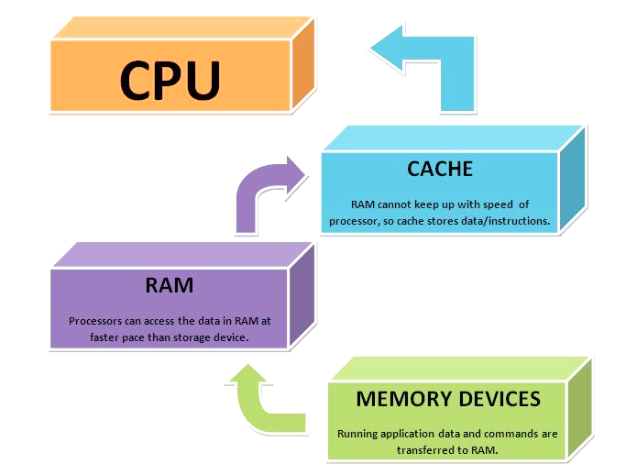
Cache Memory…
The central processing unit (CPU) of a computer uses a CPU cache as a hardware cache to lower the average cost (time or energy) of accessing data from the main memory.
Copies of the data from frequently utilized main memory locations are kept in a cache, which is a smaller, quicker memory that is situated closer to a processor core.

Slide 10


Presented by : Dinaya Madhurya

